Slide 1






COVID-19 Open Research Dataset Challenge
NATURAL LANGUAGE PROCESSING AND
TOPIC MODELING: FINDING RELATED ARTICLES
Team members:
Tahani Alqahtani – Amani Albalawi.

Slide 2



Objectives
Workflow
Dataset
Tools
Data preprocessing
Outline:
Topic Modelling
Clustering Data

Slide 3



Objective:
In this project we will find related articles by using Topic modelling. Here I am using, LSA , NMF , CorEx, and LDA. All this topic models are used to classify text in a document to a particular topic. It builds a topic per document model and words per topic model.

Slide 4

WORKFLOW
FROM START TO FINISH
Read Data
Data Preprocessing
Topic Modelling
clustering
from Kaggle
preprocessing the raw data
NMF, LSA, LDA, and CoreX
K-mens

Slide 5

We have made this dataset
available on Kaggle and we use abstract column
to make my model .
Dataset

Slide 6







Tools & libraries:
Libraries
Technologies

Slide 7

2
1
Remove stop word
3
Remove Numbers,
Capital litters and Punctuation
Tokenizing and Lemmatizing
Data Preprocessing

Slide 8


Topic Modelling
NMF
LSA
Topics(10)
CV & TFIDF
Topics(10)
CV & TFIDF
CorEx
LDA
Topics(5)
CV & TFIDF
Topics(2-10)
CV & TFIDF
Best model was Count Vectorizer LDA with 4 topics

Slide 9
LDA

Slide 10
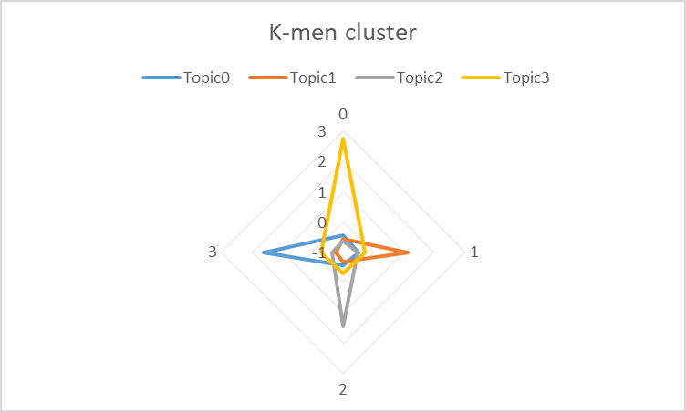

Clustering Model

Slide 11



Any question?
Thanks

